Slide 1
Overview of PCAS 1
Software Engineering CSE435
Michigan State University
Fall 2013
Team members:
Project Manager: Ally Bannon
Facilitator: Elaina Frydel
Artifact Manager: Andrew Naumoff
Customer Liaison: Will Gamba
Security Manager: Drew Peterson
Customer: Mr. Chris Capaldi
Instructor: Dr. Betty H.C. Cheng*
*Please direct all inquiries to the instructor.

Slide 2
Project Overview
The system provides an autonomous vehicle with constand sensors which will detect pedestrians and break the vehicle before a collision can occur.
Motivation for project:
A desire to reduce the number of collisions with pedestrians.
To facilitate greater safety in automobiles

Slide 3
Overview of Features
Sensors capable of detecting pedestrians
Brake-by-wire system capable of slowing the acceleration of the vehicle to a stop
Drive-by-wire system capable of returning vehicle back to a steady state speed.
Encryption build into the communication between subsystems.

Slide 4
Domain Research
•Investigated autonomous vehicle safety
•Needed to apply domain knowledge on our pedestrian collision avoidance system
•Project Constraints
– Absolutely no collisions in our testing
– Minimize impact of PCAS system on efficiency
– Address potential for cybersecurity risks

Slide 5
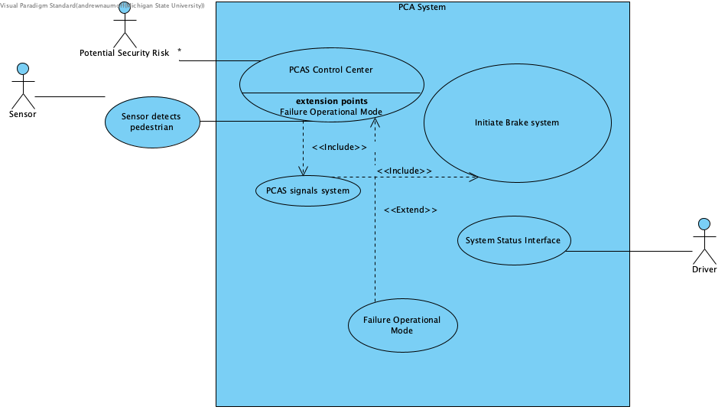
Use Case Diagram
Sensor serves as use case input.
PCAS Control Center serves as the main Decision making component.
Driver can checks status of PCAS through dashboard.
PCAS decides when to activate failure operational mode.

Slide 6
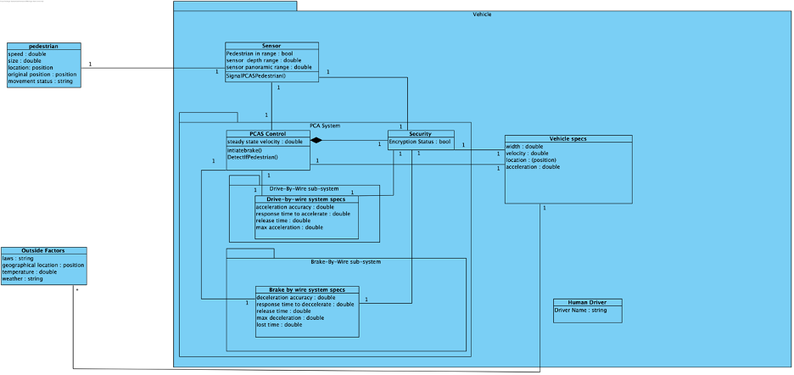
Domain Model

Slide 7
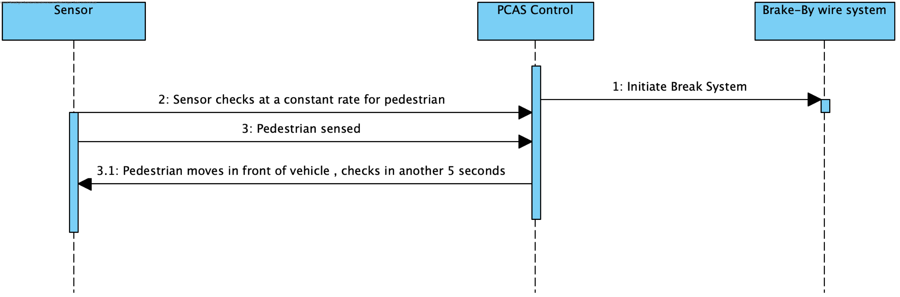
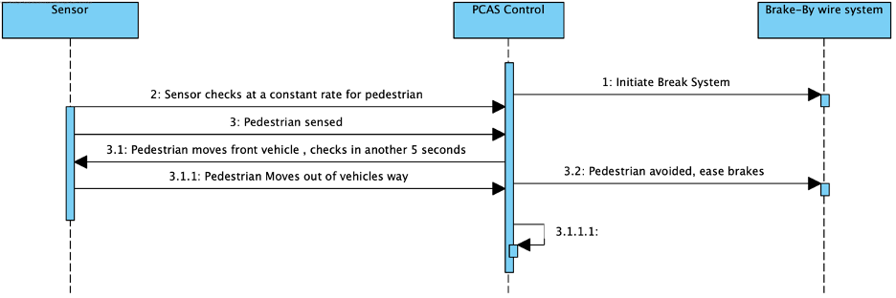
Potential Scenarios / Sequence Diagrams
Scenario when a pedestrian is stopped in front of the vehicle.
Scenario when a pedestrian is stopped in front of the vehicle and the pedestrian moves out of vehicles way.

Slide 8
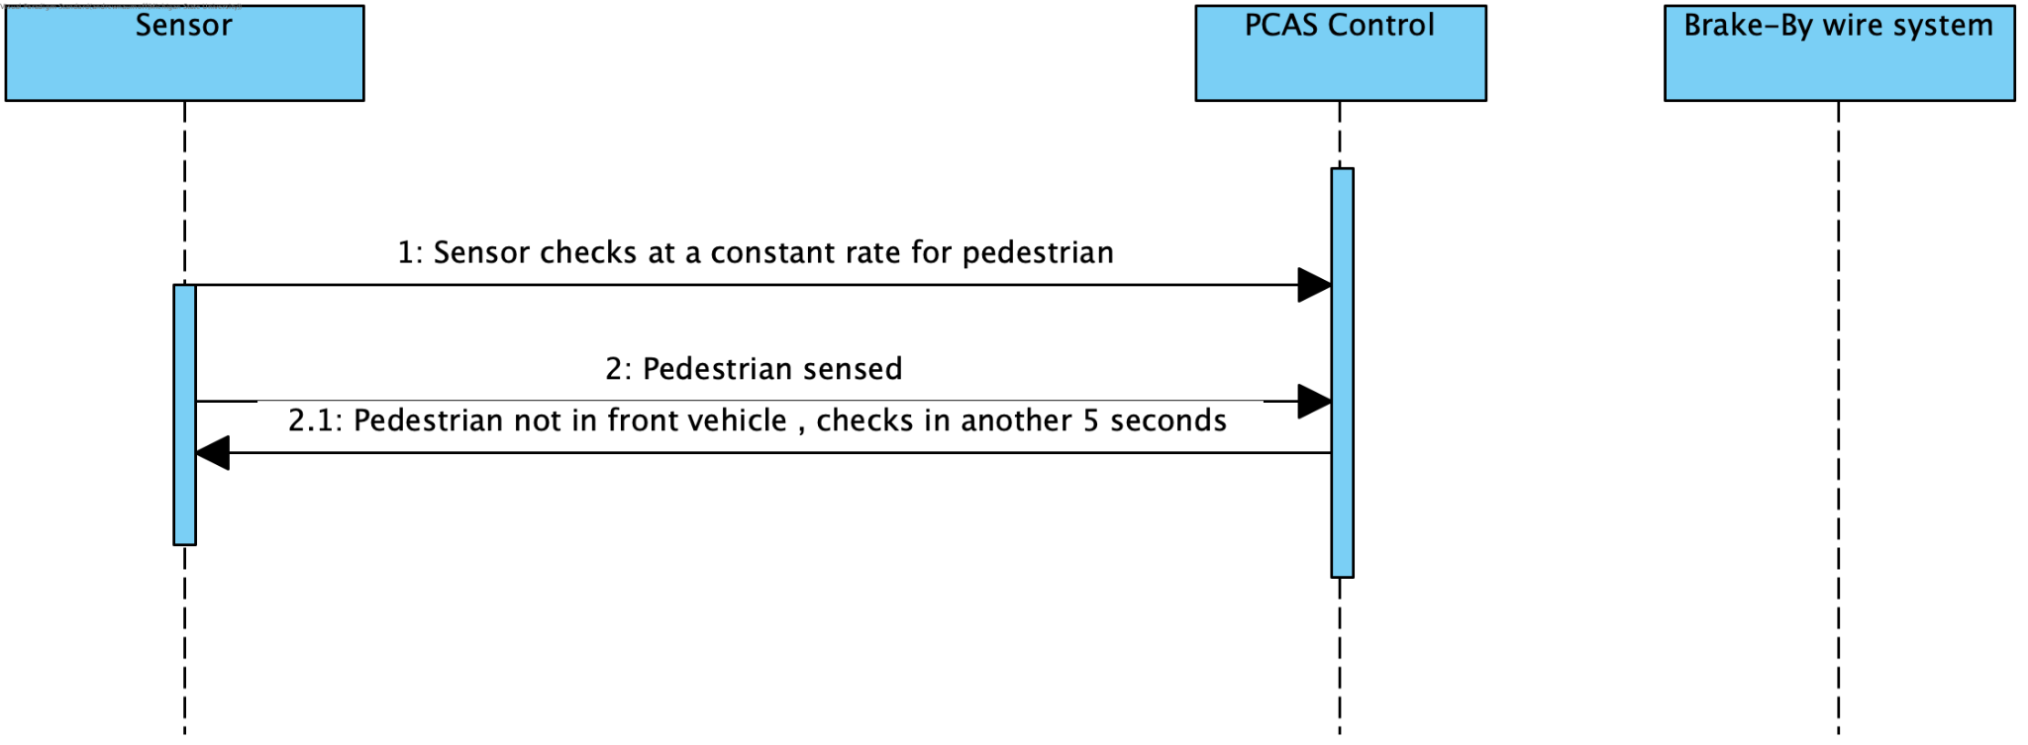
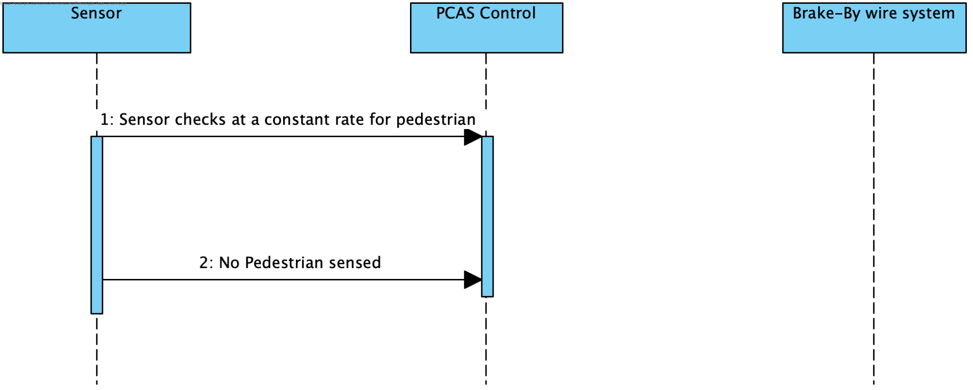
Potential Scenarios / Sequence Diagrams
Scenario when pedestrian is sensed but not within range of vehicle.
Scenario when pedestrian nor object detected by sensor.

Slide 9
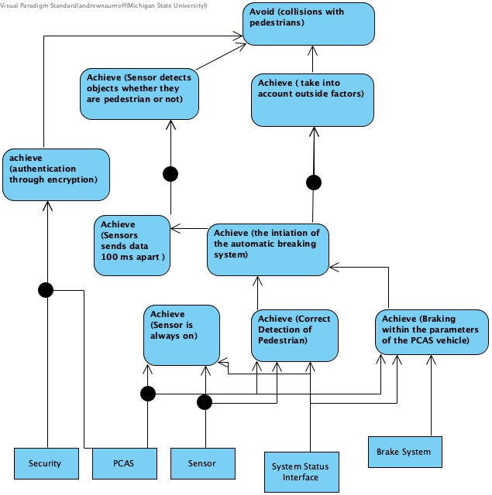
State Diagram
The main goal of the system is to avoid collisions.
The sensor detects if object is pedestrian or not.
PCAS also takes into account outside factors.
PCAS also takes into account the limits and specifications of the vehicle while braking.

Slide 10
Demonstration 1
Pedestrian moving then stops in the vehicles pathway. Moving then stopped scenario 1.

Slide 11
Demonstration 2
Pedestrian is stopped then moves away from vehicle path. Static then moving scenario 5.

Slide 12
Demonstration 3
Pedestrian starts static below the vehicle path, then moves through and out of the vehicle path (Scenario 7)

Slide 13
Demonstration 4
Pedestrian starts and remains static in the vehicle path (Scenario 8)

Slide 14
Acknowledgements
We gratefully acknowledge and appreciate the participation of our customer, Mr. Chris Capaldi from Auto Konnect.

